Slide 1
MATERIALS ENGINEERING MT30001 3-0-0
Offered by:
Metallurgical & Materials Engineering Dept.
Instructors:
Prof. Siddhartha Roy
Prof. Sujoy Kumar Kar

Slide 2
Instructor’s contact information
Prof. Siddhartha Roy
Email: siddhartha@metal.iitkgp.ernet.in
Office: First floor of Metallurgical & Materials Engineering Department, IIT Kharagpur

Slide 3
Concept of alloying

Slide 4
Content of this course
Definition of an alloy
Alloy classification
Order-disorder transformation
Textbooks referred to:
Physical Foundations of Materials Science – G. Gottstein
Introduction to Physical Metallurgy – S. H. Avner
Majority of the images in this course have been collected from different textbooks and scientific documents available in internet. They are not from my own research and have been used solely here for teaching purpose

Slide 5
Definition of an alloy
An alloy is a material that has metallic characteristics and is composed of at least two or more chemical elements, of which one is a metal.
An alloy system made up of only two elements is known as binary alloy.
Alloy system made up of three elements is known as ternary alloy.
Frequently an alloy consists several elements
Examples of technologically important alloys
Steel is primarily an alloy of iron and carbon
Brass is primarily an alloy of copper and zinc
Bronze is primarily an alloy of copper and tin

Slide 6
Why do alloying
Pure metals are often very soft. Alloying enhances the strength and hardness of metals.
Melting point of pure metals is high. Alloying decreases the melting poing so that metals become more easily fusible for processing purposes.
Many metals are very reactive in pure form and hence corrodes very easily. Alloying can enhances the corrosion resistance of the metal, thereby enhanching life of the component.
Alloying can sometimes alter the colour of the metal

Slide 7
Alloy classification
Alloy
Homogeneous
Mixture
Any combination of solid phases
Solid solution
Intermediate alloy phase
Substitutional
Intermetallic
Interstitial
Interstitial
Electron

Slide 8
Alloy classification
Alloy
Homogeneous
Mixture
Any combination of solid phases
Solid solution
Intermediate alloy phase
Substitutional
Intermetallic
Interstitial
Interstitial
Electron

Slide 9
Alloy classification
Homogeneous alloy
A homogeneous alloy consists of a single phase
An alloy can be homogeneous only if it is a solid solution or an intermediate alloy phase

Slide 10
Alloy classification
Mixture
An alloy in mixture form is composed of any combination of solid phases each having distinct composition and properties; e.g.:
Mixture of two pure metals
Mixture of two solid solutions
Mixture of two compounds
Mixture of a metal and a solid solution
The properties of a heterogeneous mixture are sensitive to the way it is processed.

Slide 11
Alloy classification
Alloy
Homogeneous
Mixture
Any combination of solid phases
Solid solution
Intermediate alloy phase
Substitutional
Intermetallic
Interstitial
Interstitial
Electron

Slide 12
Intermediate alloy phase
Intermediate alloy phases are phases whose chemical compositions are intermediate between the two pure phases and generally have crystal structures different from the pure elements.
Stoichiometric
They have a fixed composition and are represented by a vertical line in phase diagram
Nonstoichiometric
They have a range of compositions and are represented by an area in the phase diagram

Slide 13
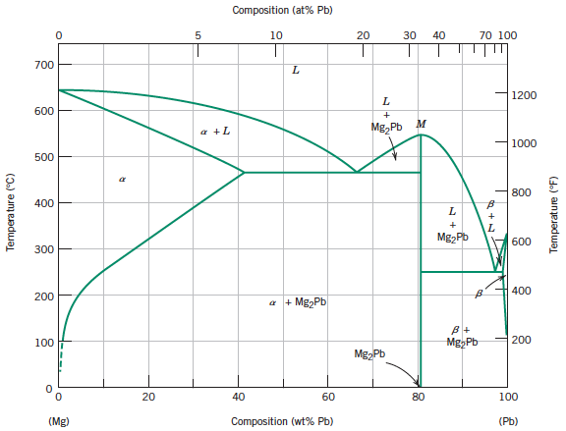
Stoichiometric compound

Slide 14
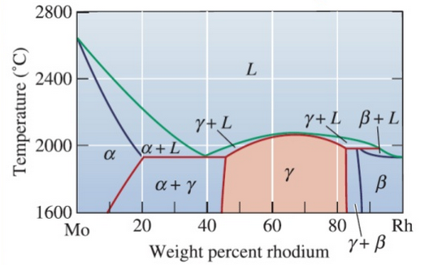
Nonstoichiometric compound

Slide 15
Intermetallic compounds
Generally formed between chemically dissimilar metals following the rules of chemical valence.
They generally have ionic and/or covalent bonding and their properties are non-metallic
They are typically very hard and brittle
Examples of intermetallic compounds
Mg₂Pb, Mg₂Sn, Cu₂Se etc.

Slide 16
Interstitial compounds
These are formed between the metallic elements (like Ti, Ta, W, Fe etc.) and five relatively small elements (C, H, O, N and B).
The compounds are metallic, very high melting points, extremely hard and brittle
Examples of intermetallic compounds
TiC, TaC, Fe₃C, W₂C etc.

Slide 17
Electron compounds
They exist at definite ratios of valence electrons to atoms
Many electron compunds have high ductility and low hardness
Examples of electron compounds:
Ratio of valence electrons to atoms Examples
3:2 AgCd, Cu₃Al, AgZn etc.
7:4 AgCd₃, Cu₃Si etc.
21:13 Cu₉Al₄, Au₅Zn₈ etc.

Slide 18
Alloy classification
Alloy
Homogeneous
Mixture
Any combination of solid phases
Solid solution
Intermediate alloy phase
Substitutional
Intermetallic
Interstitial
Interstitial
Electron

Slide 19
Solid solution
A solid solution is formed when as the solute atoms are added to the host material (i.e. solvent), the crystal structure is maintained and no new structures are formed
Characteristics
The allowable amount of solute dissolvable in the solvent is a function of temperature and generally increases with increase in temperature.
The solute is generally more soluble in the liquid state than in the solid state.
Most solid solutions solidify over a range of temperatures
Solid solutions can be substitutional or interstitial

Slide 20
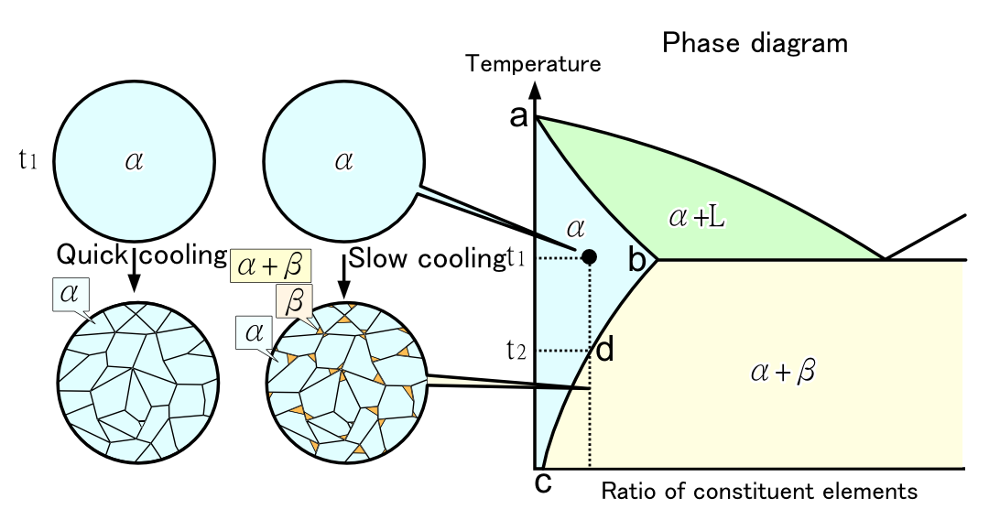
Solid solution

Slide 21
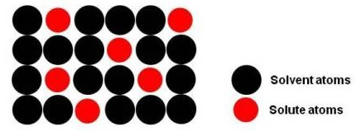
Substitutional solid solution
In this type of solution the atoms of the solute substitute for the atoms of the solvent in the lattice structure of the solvent.
Example: Gold-silver alloy

Slide 22
Factors affecting solid solubility
William Hume-Rothery proposed a set of basic factors (widely known as Hume-Rothery rules) that control the range of solubility in alloy systems
a) Crystal structure factor
Complete solid solubility of two elements is never attained unless the elements have the same type of crystal lattice structure

Slide 23
Factors affecting solid solubility
William Hume-Rothery proposed a set of basic factors (widely known as Hume-Rothery rules) that control the range of solubility in alloy systems
b) Relative size factor
Appreciable quantities of a solute may be accomodated to form substitutional solid solution only when the difference in atomic radii between the two atom types is less than 15%.

Slide 24
Factors affecting solid solubility
William Hume-Rothery proposed a set of basic factors (widely known as Hume-Rothery rules) that control the range of solubility in alloy systems
c) Electronegativity factor
The greater the difference in electronegativities of the two metals, the more restricted will be the formation of solid solutions and the greater is the tendency for a compound formation.

Slide 25
Factors affecting solid solubility
William Hume-Rothery proposed a set of basic factors (widely known as Hume-Rothery rules) that control the range of solubility in alloy systems
d) Valency factor
Complete solubility occurs when the solvent and solute have the same valency. A metal of higher valency is more likely to dissolve in a metal of lower valency.

Slide 26
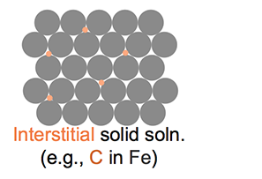
Interstitial solid solution
Interstitial solid solutions are formed, when the atoms of small atomic radii (these are C, N, H, O, B) occupy the spaces or interstices of the lattice structure of the larger solvent atoms.
Example: Steel is an alloy of carbon (interstitials) in iron (solvent)

Slide 27
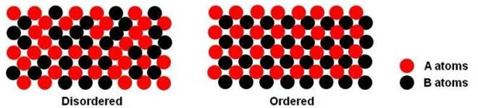
Order-disorder transformation
Ordinarily in substitutional solid solutions the solute and solvent atoms are distributed randomly in the lattice structure ➔ Disordered structure
Some random solutions if cooled slowly undergo an atomic rearrangement, whereby solute and solvent atoms occupy specific positions in the lattice structure ➔ Ordered structure or superlattice

Slide 28
Order-disorder transformation
Usually the maximum amount of ordering occurs at a simple atomic ratio of two metals ➔ ordered phase is usually given a chemical formula e.g. AuCu₃
Thermal motion of atoms tend to destroy the ordering ➔ degree of ordering ⬇ as temperature ⬆
Temperature at which the ordered state completely changes to a disordered state is called critical temperature.

Slide 29
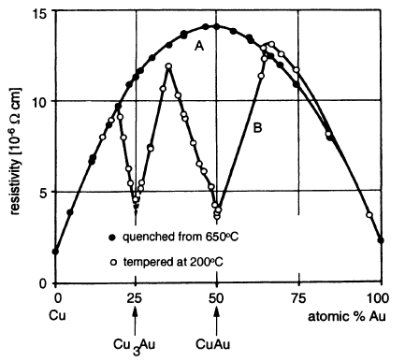
Effect of ordering on properties
If the ordered phase has the same lattice structure as the disordered phase, the effect on mechanical phase is negligible
Formation of ordered structure drastically reduces the electrical resistivity, as in an ordered structure the lattice perturbations reducing conductivity are minimal.

